Slide 1
Three Part GSR Orientation
A year long program for new GSRs
WELCOME TO THE SEPTEMBER
GSR ORIENTATION
PART 3
aageorgia.org | gssa@aageorgia.org | P.O. Box 7325 Macon, GA 31209 | Phone: 478-745-2588 | Gssa@2006

Slide 2
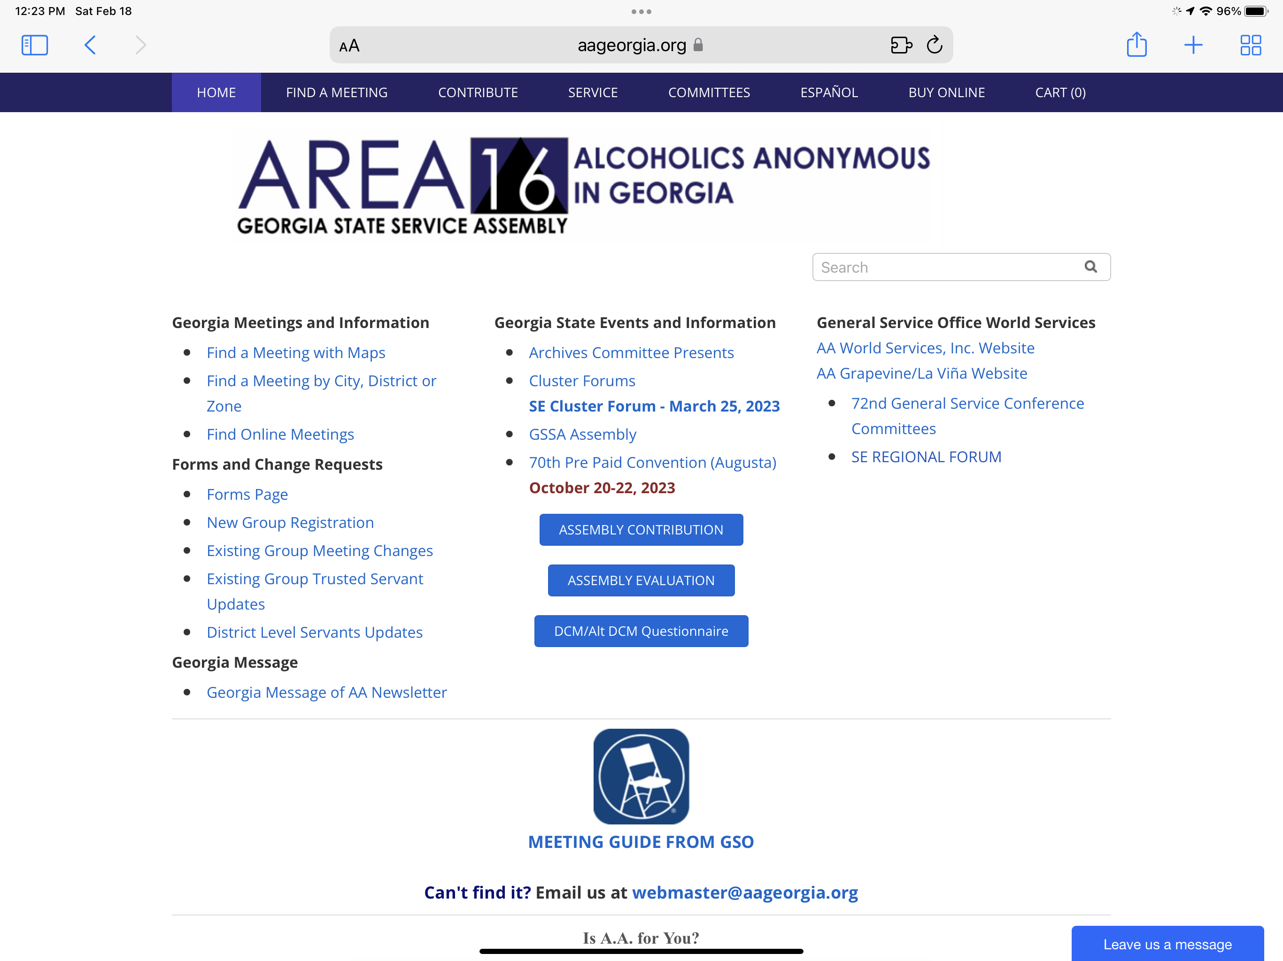
aageorgia.org

Slide 3
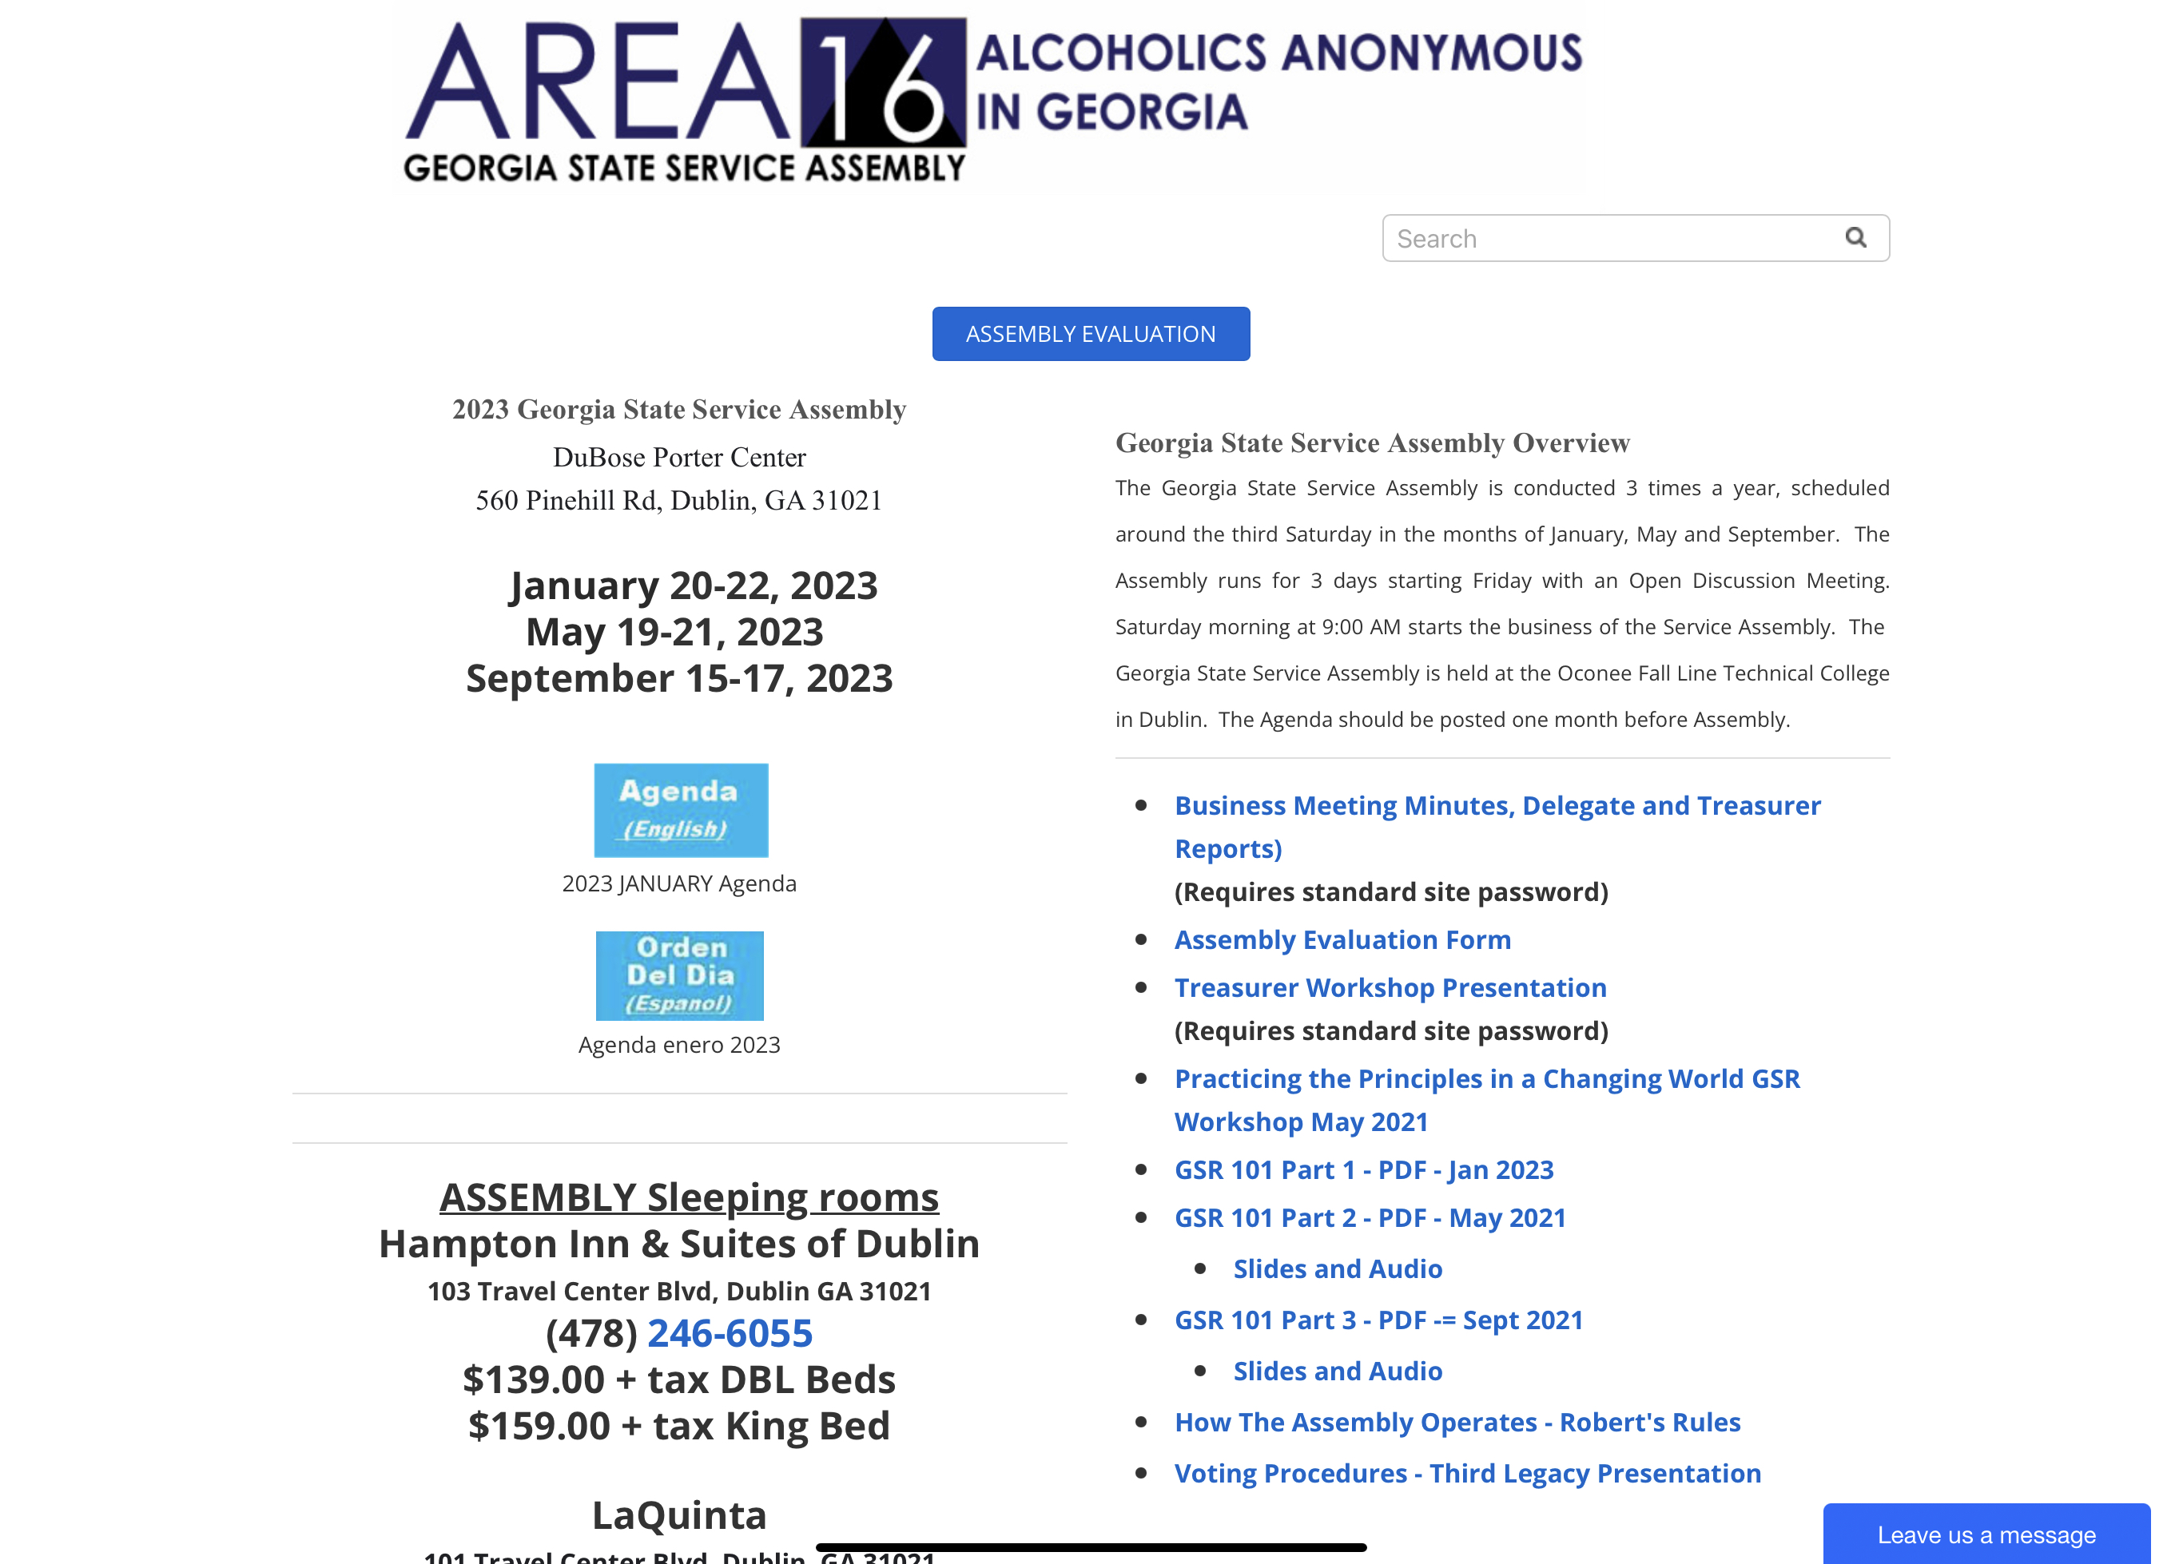

Slide 4
The GSR
“The strength of our whole A.A. service structure starts with the group and with the general service representative (G.S.R.) the group elects. I cannot emphasize too strongly the G.S.R.’s importance.”
-Bill Wilson
aageorgia.org | gssa@aageorgia.org | P.O. Box 7325 Macon, GA 31209 | Phone: 478-745-2588 | Gssa@2006

Slide 5
Who do we have here today?
Raise your hand if you are a new GSR
and this is your first Assembly.
Raise your hand if you are a 2nd year GSR.
Raise your hand if you are an Alt GSR.
Raise your hand if you are a GSR again.
Raise your hand if you are here to learn
more about service work.
aageorgia.org | gssa@aageorgia.org | P.O. Box 7325 Macon, GA 31209 | Phone: 478-745-2588 | Gssa@2006

Slide 6
Three Part GSR Orientation
A year long program for new GSRs
Part 1 – January
Qualifications/Duties
Motions at Assembly
Concepts I and II
aageorgia.org | gssa@aageorgia.org | P.O. Box 7325 Macon, GA 31209 | Phone: 478-745-2588 | Gssa@2006

Slide 7
Three Part GSR Orientation
A year long program for new GSRs
Part 2 – May
Nominating procedures
Voting and elections
Concepts III, V and IX
aageorgia.org | gssa@aageorgia.org | P.O. Box 7325 Macon, GA 31209 | Phone: 478-745-2588 | Gssa@2006

Slide 8
Three Part GSR Orientation
A year long program for new GSRs
Part 3 – September
Voting and elections
Area trusted servants
Service sponsors and group inventories
aageorgia.org | gssa@aageorgia.org | P.O. Box 7325 Macon, GA 31209 | Phone: 478-745-2588 | Gssa@2006

Slide 9
The GSR
Recap of Part 1
CONCEPTS I AND II
WHY IS THE GSR IMPORTANT?
GSR QUALIFICATIONS AND DUTIES
THE ROLE OF THE GSR AT GSA
THE ROLE OF THE ALT GSR AT GSSA
aageorgia.org | gssa@aageorgia.org | P.O. Box 7325 Macon, GA 31209 | Phone: 478-745-2588 | Gssa@2006

Slide 10
CONCEPTS I AND II
Concept I
The final responsibility and the ultimate authority for A.A. World services should always reside in the collective conscience of our whole Fellowship.
Concept II
When, in 1955, the A.A. groups confirmed the permanent charter for their General Service Conference, they thereby delegated to the Conference complete authority for the active maintenance of our world services and thereby made the Conference – excepting for any change in the Twelve Traditions or in Article 12 of the Conference Charter – the actual voice and the effective conscience for our whole Society.
aageorgia.org | gssa@aageorgia.org | P.O. Box 7325 Macon, GA 31209 | Phone: 478-745-2588 | Gssa@2006

Slide 11
Why is the GSR so important?
GSRs are responsible for electing the actual voice and effective conscience of our whole society.
AND
GSRs are the group conscience of our Georgia State Service Assembly (GSSA)
aageorgia.org | gssa@aageorgia.org | P.O. Box 7325 Macon, GA 31209 | Phone: 478-745-2588 | Gssa@2006

Slide 12
GSR Qualifications and Duties
Qualifications
Duties
Active in groups and surrounding activities
Experienced in using Traditions to solve problems
A desire to serve
At least 2 years of sobriety
Time to attend meetings
Confidence of the group
An open mind
Attend District/Zone meetings
Attend GSSA
Group contact for GSO
Keep group information updated with DCM
Knowledgeable about material from GSO
Willing to learn about the Traditions
Participate in group steering committees and planning activities
Participate in District service functions
Bring your group’s conscience to your District and Area 16
Deliver the message from your District and Area 16 back to your group
aageorgia.org | gssa@aageorgia.org | P.O. Box 7325 Macon, GA 31209 | Phone: 478-745-2588 | Gssa@2006

Slide 13
Role of the GSR & Alt GSR at GSSA
Role of the GSR
Make motions
Vote on all matters
Be informed
Nominate Area trusted servants
Elect Area trusted servants
Role of the Alt GSR
Attend with GSR to learn – Cannot act
Attend in place of the GSR and assume GSR’s duties
aageorgia.org | gssa@aageorgia.org | P.O. Box 7325 Macon, GA 31209 | Phone: 478-745-2588 | Gssa@2006

Slide 14
The GSR
Recap of Part 2
NOMINATING PROCEDURES
VOTING AND ELECTIONS
CONCEPTS III, V, IX
aageorgia.org | gssa@aageorgia.org | P.O. Box 7325 Macon, GA 31209 | Phone: 478-745-2588 | Gssa@2006

Slide 15
Area Trusted Servant Nominations
GSRs elect our Delegate, Alternate Delegate, Treasurer, and Secretary
The Delegate and Alternate Delegate are elected in odd years, and Treasurer and Secretary are elected in even years
Nominations are made in May from the floor by a GSR and seconded by a GSR
Our Delegate nominees can also come from roll call of the qualified DCMs
This Assembly we will nominate Delegate and Alternate Delegate candidates
aageorgia.org | gssa@aageorgia.org | P.O. Box 7325 Macon, GA 31209 | Phone: 478-745-2588 | Gssa@2006

Slide 16
Nomination Procedure
Nominate a qualified candidate
Qualifications are in the Georgia A.A. Service Manual
Delegates and Alternate Delegates must be a past DCM and meet all the other qualifications
Make sure your candidate is available and willing to serve
Arrange in advance a GSR to second your nomination
The second should be someone who supports your nomination
Once all nominations are complete, the chairperson will ask for a show of hands to close the nominations
aageorgia.org | gssa@aageorgia.org | P.O. Box 7325 Macon, GA 31209 | Phone: 478-745-2588 | Gssa@2006

Slide 17
Election Procedure and Voting
We use the Third Legacy Procedure for our elections (p 29-31 of the Georgia AA Service Manual)
The winning candidate mush have 2/3 of the vote, or have been drawn from the hat
First Ballot – All candidates are on the ballot, if no one receives 2/3 majority we go to a second ballot
Second Ballot – All candidates are on the ballot, if no one receives 2/3 majority we go to a third ballot
Third Ballot – All candidates who received less that 1/5 of the vote in the second ballot are removed, and the remaining candidates are now voted on, and if no one receives 2/3 majority, we go to a fourth ballot
Fourth Ballot – Any candidates that did not receive 1/3 of the vote in the third ballot are removed. The remaining candidates are now voted on, and if no one receives a 2/3 majority, we go to a fifth ballot
Fifth Ballot – Only the top 2 candidates will participate in the Fifth and Final Ballot. If neither candidate receives a 2/3 majority, their names will go to the hat and the new Area Officer will be drawn from the hat.
aageorgia.org | gssa@aageorgia.org | P.O. Box 7325 Macon, GA 31209 | Phone: 478-745-2588 | Gssa@2006

Slide 18
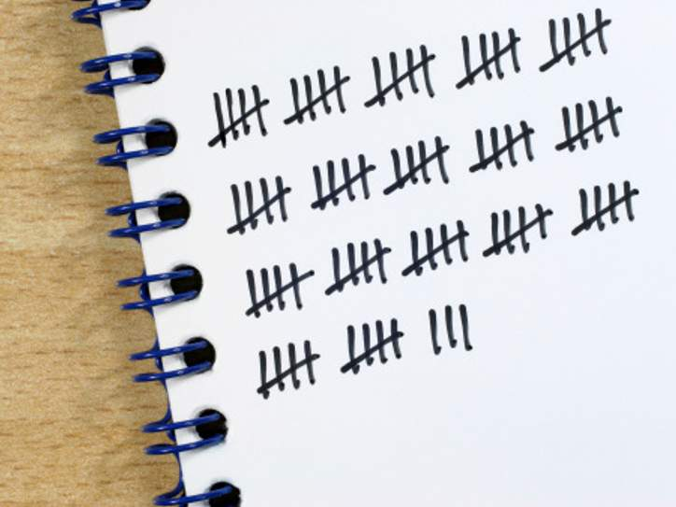
GSRs and Voting
Elections
Only GSRs can vote at GSSA
GSRs must sign in at the Assembly no later than 9am Sunday morning to be eligible to vote
We currently use paper ballots for elections
The DCM will hand out ballot sheets to each GSR in their District or Zone
Each GSR will write the name of the candidate they are voting for on the ballot paper, fold it in half, and hand it back to their DCM
The ballots will be carried to the podium to be counted
Counting the ballots happens by tallying
The chairperson will announce each ballot
There will be one person marking the tally board and two additional counters on the podium
You can only vote if you are in the room – if you miss the vote, there is no vote for your group
aageorgia.org | gssa@aageorgia.org | P.O. Box 7325 Macon, GA 31209 | Phone: 478-745-2588 | Gssa@2006

Slide 19
Helpful Concepts for Nominating and Voting
Concept III – Right of Decision
We trust our responsible leaders to decide
Concept V – Right of Appeal
Minority opinion will be heard
Concept IX – Service Leadership
We must take care in selecting our trusted servants
aageorgia.org | gssa@aageorgia.org | P.O. Box 7325 Macon, GA 31209 | Phone: 478-745-2588 | Gssa@2006

Slide 20
Recap Questions
aageorgia.org | gssa@aageorgia.org | P.O. Box 7325 Macon, GA 31209 | Phone: 478-745-2588 | Gssa@2006

Slide 21
GSR Orientation
Part 3
Responsibilities of Area Trusted Servants
Service Sponsors
Group Inventories
aageorgia.org | gssa@aageorgia.org | P.O. Box 7325 Macon, GA 31209 | Phone: 478-745-2588 | Gssa@2006

Slide 22
Ares Trusted Servants
Office Committee
Delegate – attends the General Service Conference in New York, attends Area events, plans the Assembly, reports to the Assembly
Alternate Delegate – contact for the Prepaid Convention committees and Cluster Forums, attends area events, available to fill in for the Delegate
Chairperson (immediate past Delegate) – plan Assembly business meeting, familiar with meeting procedures, chair the assembly business meeting, reviews motions with motion makers
aageorgia.org | gssa@aageorgia.org | P.O. Box 7325 Macon, GA 31209 | Phone: 478-745-2588 | Gssa@2006

Slide 23
Ares Trusted Servants
Office Committee
Office Committee Chairperson (immediate past Chairperson) – chair the office committee meetings, supervise Area office manager on behalf of the office committee, sometimes acts as parliamentarian
Secretary – assist with preparing the Assembly agenda, keep accurate minutes of Assembly Business Meeting, attend Area events, keep up-to-date group records, back up the Area Treasurer
Treasurer – provide financial reports, monitor spending, issue expense checks, attend Area events, back up Area Secretary
aageorgia.org | gssa@aageorgia.org | P.O. Box 7325 Macon, GA 31209 | Phone: 478-745-2588 | Gssa@2006

Slide 24
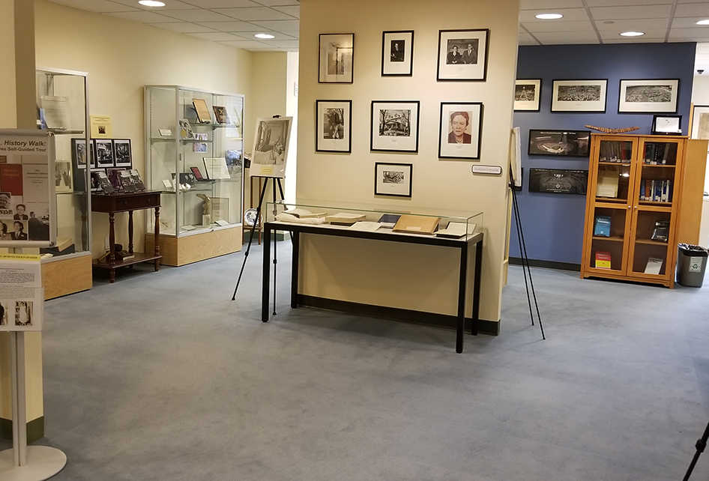
Ares Special Workers
State (Area) Office Manager – manages the office correspondence, group contributions, online and printed Area Directory, group records, Area archives, literature distribution. Also is a member of the Office Committee.
State Office Assistant – assists manager with all duties, but they are not a member of the Office Committee.
aageorgia.org | gssa@aageorgia.org | P.O. Box 7325 Macon, GA 31209 | Phone: 478-745-2588 | Gssa@2006

Slide 25
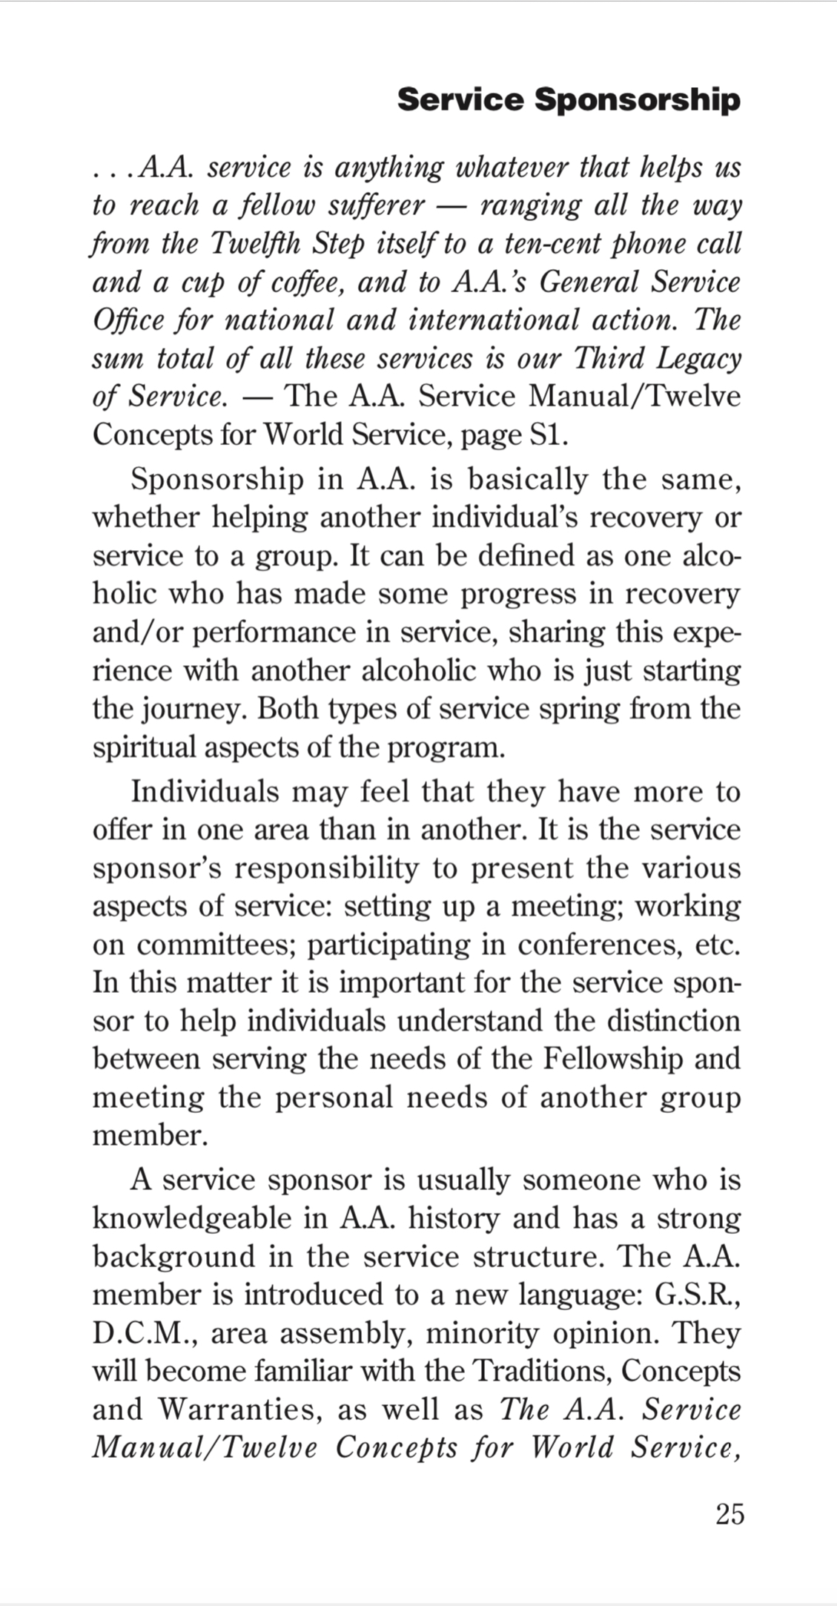
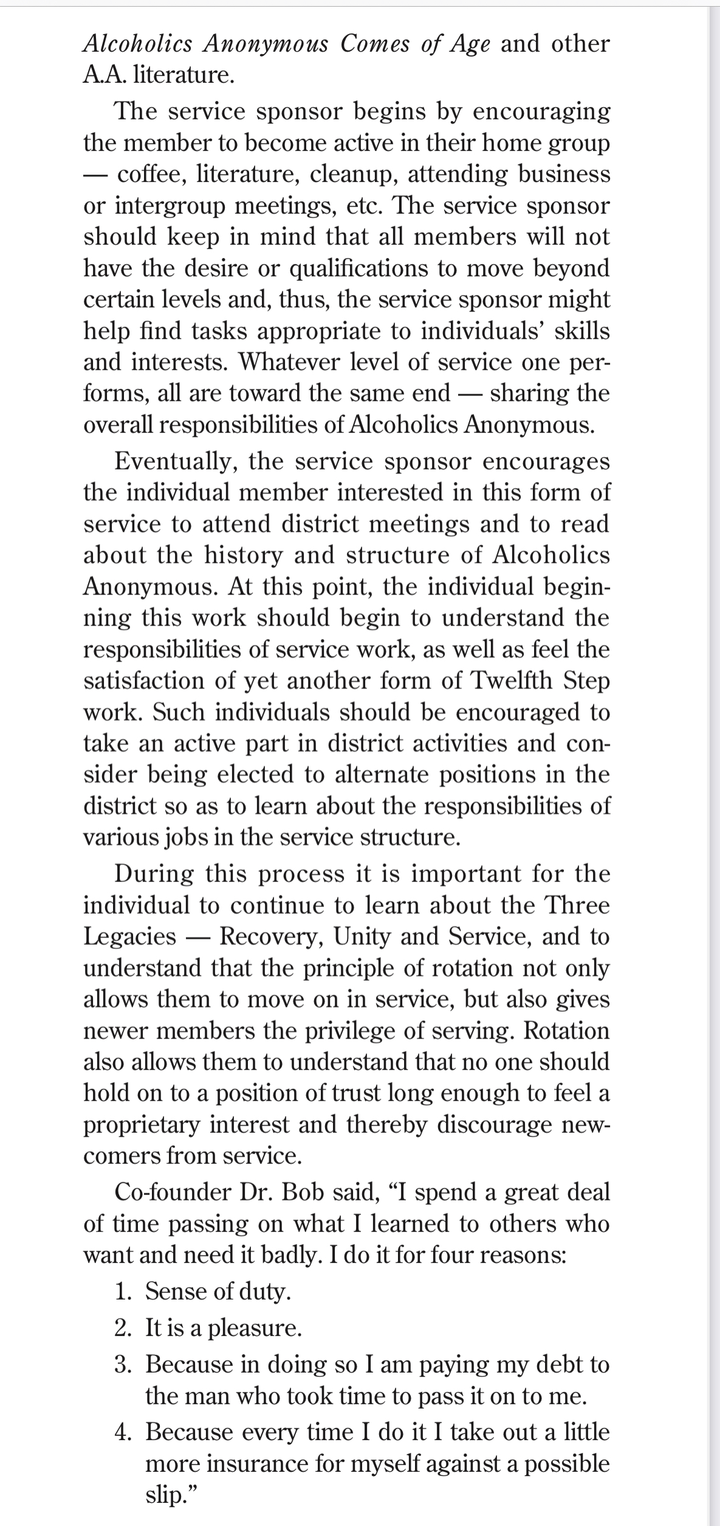
Other Helpful Topics
Service sponsor – someone that has knowledge of the Traditions, Concepts and Warranties and experience in service work that can share their experience, strength and hope.
aageorgia.org | gssa@aageorgia.org | P.O. Box 7325 Macon, GA 31209 | Phone: 478-745-2588 | Gssa@2006

Slide 26
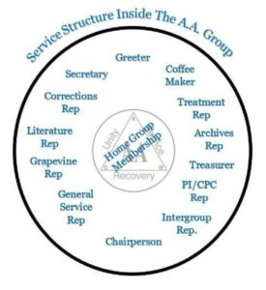
Other Helpful Topics
Group inventory – a meeting to review the group’s effectiveness at fulfilling our primary purpose: to help alcoholic’s recover through the AA program. There are multiple methods for conducting a group inventory – see pamphlet, The AA Group.
aageorgia.org | gssa@aageorgia.org | P.O. Box 7325 Macon, GA 31209 | Phone: 478-745-2588 | Gssa@2006

Slide 27
A.A. Group Inventory (pg. 29-30)
Many groups periodically hold a “group inventory meeting” to evaluate how well they are fulfilling their primary purpose: to help alcoholics recover through A.A.’s suggested Twelve Steps of recovery. Some groups take inventory by examining our Twelve Traditions, one at a time, to determine how well they are living up to these principles.
The following questions, compiled from A.A. shared experience, may be useful in arriving at an informed group conscience. Groups will probably wish to add questions of their own:
1. What is the basic purpose of our group? 2.What more can our group do to carry the message?
Is our group attracting alcoholics from different backgrounds? Are we seeing a good cross- section of our community, including those with accessibility issues?
Do new members stick with us, or does the turn- over seem excessive? If so, why? What can we as a group do to retain members?
Do we emphasize the importance of sponsor- ship? How effectively? How can we do it better?
Are we careful to preserve the anonymity of our group members and other A.A.s outside the meeting rooms? Do we also leave what they share at meetings behind?
Does our group emphasize to all members the value of keeping up with the kitchen, set-up, clean-up and other housekeeping chores that are essential for our Twelfth Step efforts?
Are all members given the opportunity to speak at meetings and to participate in other group activities?
Mindful that holding office is a great responsibility not to be viewed as the outcome of a popularity contest, are we choosing our officers with care?
Are we doing all we can to provide a safe, attractive and accessible meeting place?
Does our group do its fair share toward participating in the purpose of A.A. — as it relates to our Three Legacies of Recovery, Unity and Service?
What has our group done lately to bring the A.A. message to the attention of professionals in the community — the physicians, clergy, court officials, educators and others who are often the first to see alcoholics in need of help?
How is our group fulfilling its responsibility to the Seventh Tradition?

Slide 28
The 12 Traditions
The Traditions and
Solving Group Problems
aageorgia.org | gssa@aageorgia.org | P.O. Box 7325 Macon, GA 31209 | Phone: 478-745-2588 | Gssa@2006

Slide 29
The 12 Traditions
Our common welfare comes first; personal recovery depends upon A.A. unity.
For our group purpose there is but one ultimate authority – a loving God as He may express Himself in our group conscience. Our leaders are but trusted servants; they do not govern.
The only requirement for A.A. membership is a desire to stop drinking.
Each group should be autonomous except in matters affecting other groups or A.A. as a whole.
Each group has but one primary purpose – to carry its message to the alcoholic who still suffers.
An A.A group ought never endorse, finance, or lend the A.A. name to any related facility or outside enterprise, lest problems of money, property, and prestige divert us from our primary purpose.
Every A.A. group ought to be fully self-supporting, declining outside contributions.
Alcoholics Anonymous should remain forever non-professional, but our service centers may employ special workers.
A.A., as such, ought never be organized; but we may create service boards or committees directly responsible to those they serve.
Alcoholics Anonymous has no opinion on outside issues; hence the A.A. name ought never be drawn into public controversy.
Our public relations policy is based on attraction rather than promotion; we need always maintain personal anonymity at the level of press, radio, and films.
Anonymity is the spiritual foundation of all our traditions, ever reminding us to place principles before personalities.
aageorgia.org | gssa@aageorgia.org | P.O. Box 7325 Macon, GA 31209 | Phone: 478-745-2588 | Gssa@2006

Slide 30
There is a group member that comes early to set up and talks to a church member about politics…
He had very radical views that may have been misconstrued as AA’s opinion since he was the AA guy setting up the meeting.
What tradition applies to this situation?
Tradition 10 - Alcoholics Anonymous has no opinion on outside issues; hence the A.A. name ought never be drawn into public controversy.
aageorgia.org | gssa@aageorgia.org | P.O. Box 7325 Macon, GA 31209 | Phone: 478-745-2588 | Gssa@2006

Slide 31
There is an oldtimer who continually brings small gifts for new members of the opposite sex.
The oldtimer will call and text these newcomers asking them to go out.
What tradition applies to this situation?
Tradition 1 – Our common welfare should come first; personal recovery depends upon A.A. unity.
13th Stepping ☺
aageorgia.org | gssa@aageorgia.org | P.O. Box 7325 Macon, GA 31209 | Phone: 478-745-2588 | Gssa@2006

Slide 32
A halfway house brings residents to the meeting. They behave badly and are disruptive.
The meeting usually has 6-10 residents that sit together, talk, and get up constantly.
What tradition applies to this situation?
Tradition 1 – Our common welfare should come first; personal recovery depends upon A.A. unity.
The whole is more important than the few.
But we can first try talking to the halfway house and then befriending the residents and kindly telling them to settle down.
aageorgia.org | gssa@aageorgia.org | P.O. Box 7325 Macon, GA 31209 | Phone: 478-745-2588 | Gssa@2006

Slide 33
Final Questions
aageorgia.org | gssa@aageorgia.org | P.O. Box 7325 Macon, GA 31209 | Phone: 478-745-2588 | Gssa@2006

Slide 34
AA Responsibility Pledge
“I am responsible, when anyone, anywhere, reaches out for help, I want the hand of AA always to be there, and for that I am responsible.”
(Toronto International Convention 1965)
aageorgia.org | gssa@aageorgia.org | P.O. Box 7325 Macon, GA 31209 | Phone: 478-745-2588 | Gssa@2006

