Slide 1
aageorgia.org
aageorgia.org | gssa@aageorgia.org | P.O. Box 7325 Macon, GA 31209 | Phone: 478-745-2588 | Gssa@2006

Slide 2
2023 Area Directory Updates
When making changes to group information, place only one line through the old information, then PRINT any corrections next to, just above or below the information provided on the Group Information Sheet.
District Officers Change Forms are also in the packet. Please update those as well.
If you are missing groups in your district, or have groups included which are not in your district, please contact Tamera at 478.745.2588 or by email at gssa@aageorgia.org as soon as possible.
Please return all sheets directly to the State Office prior to the DCM Planning meeting Saturday, November 5, 2022, or mail them in the provided envelope before then.
aageorgia.org | gssa@aageorgia.org | P.O. Box 7325 Macon, GA 31209 | Phone: 478-745-2588 | Gssa@2006

Slide 3
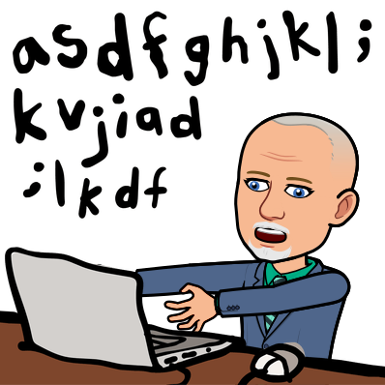
This is our site aageorgia.org
From here click home

Slide 4
To add or change District Officer information

Slide 5
Note the hours of operation

Slide 6
Select your district and/or zone
aageorgia.org | gssa@aageorgia.org | P.O. Box 7325 Macon, GA 31209 | Phone: 478-745-2588 | Gssa@2006

Slide 7
Where we put the entire psychic changes
Don’t forget to click submit

Slide 8
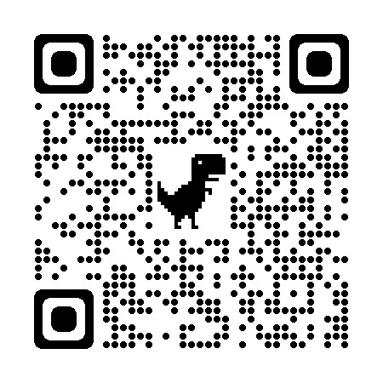
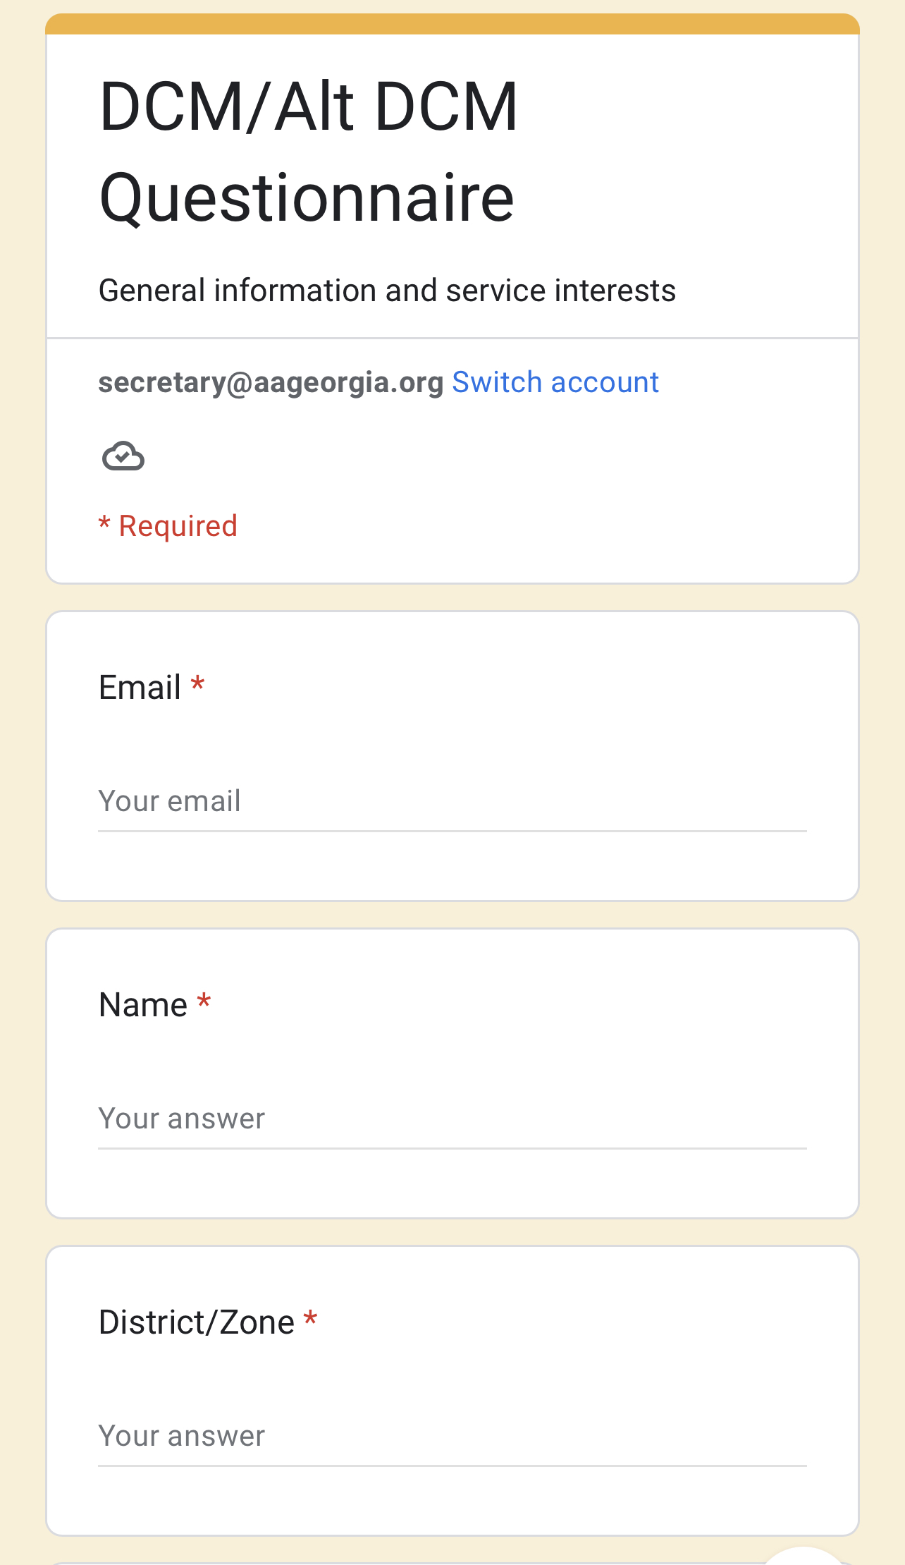
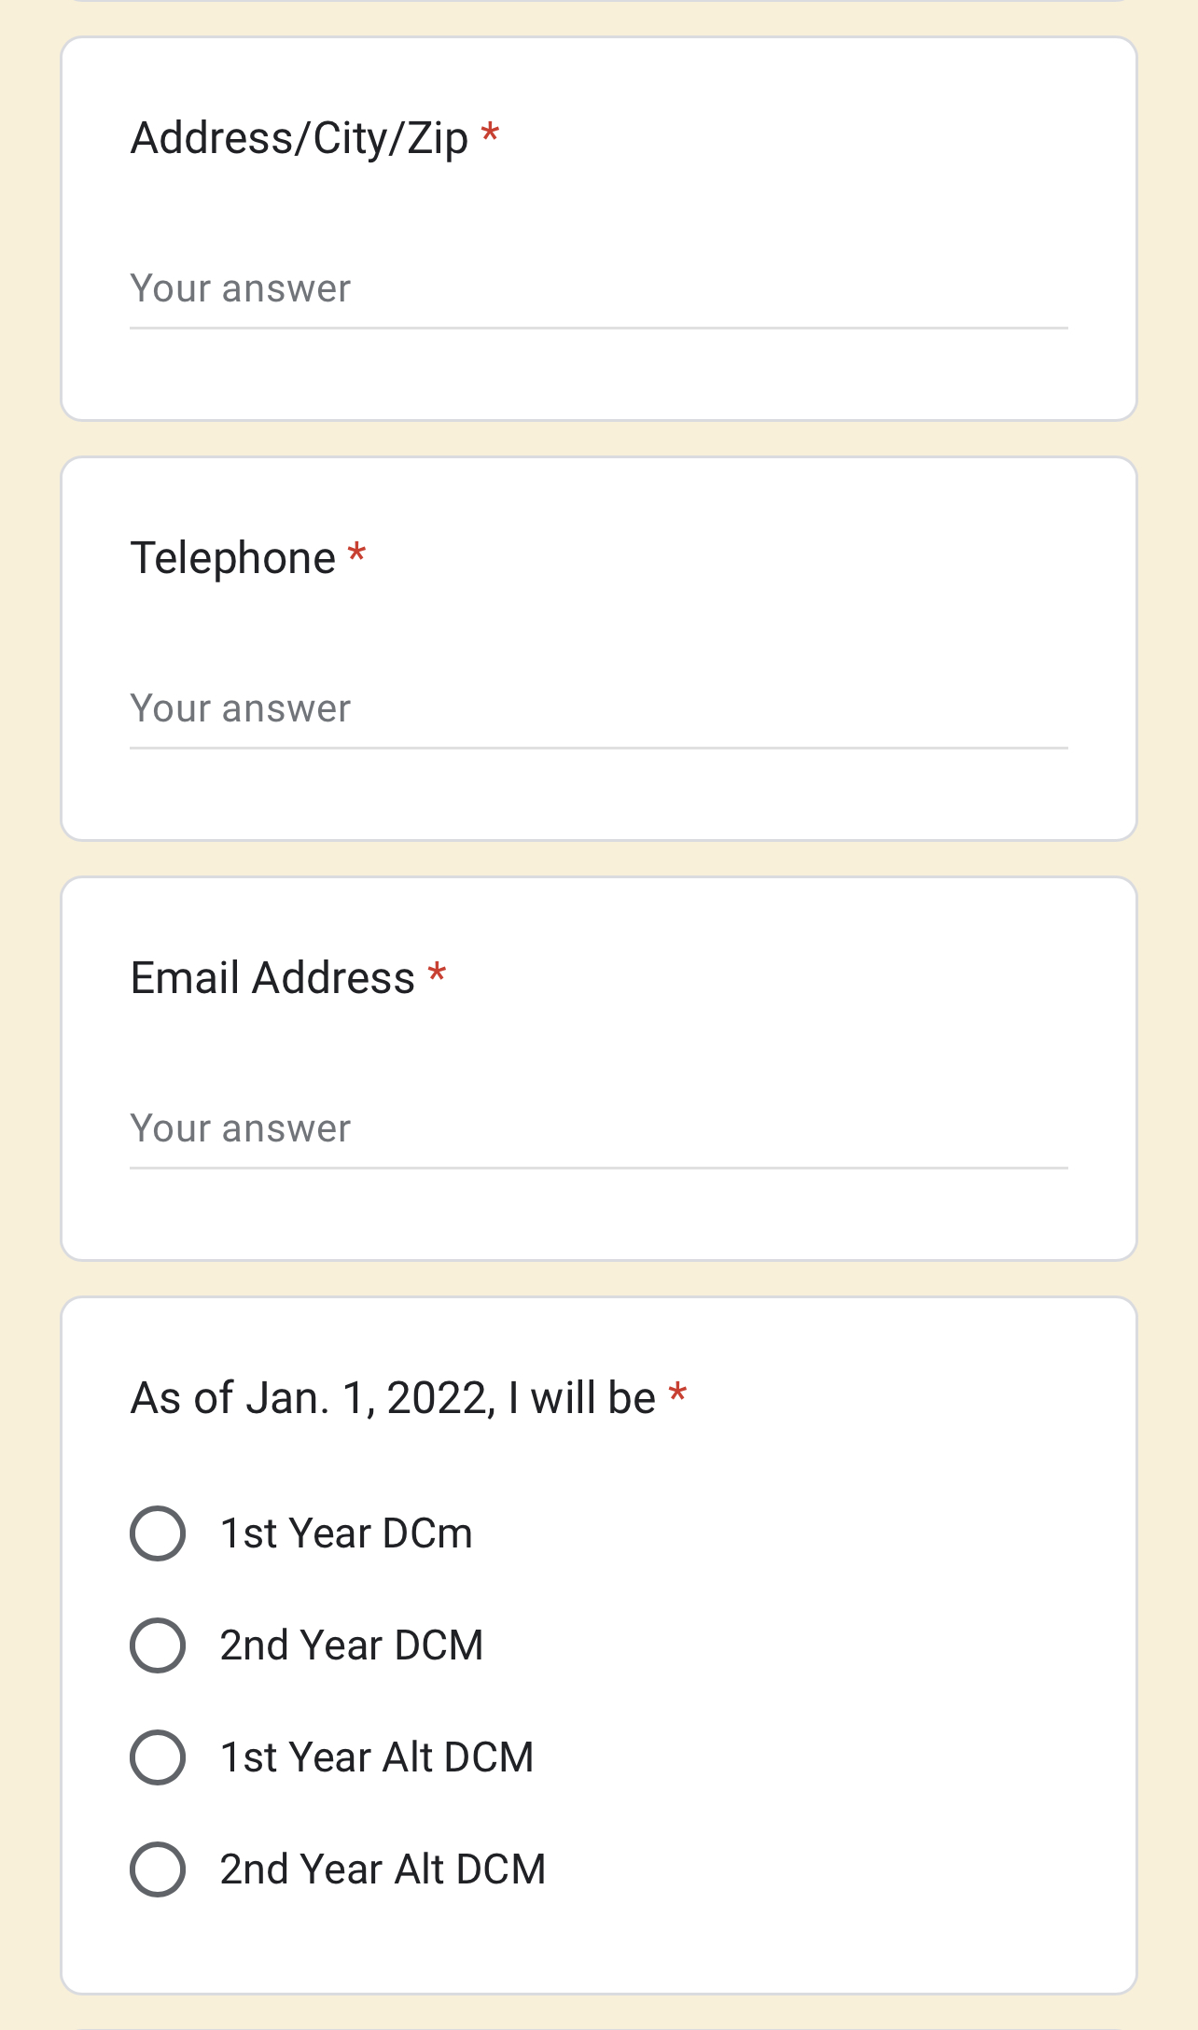
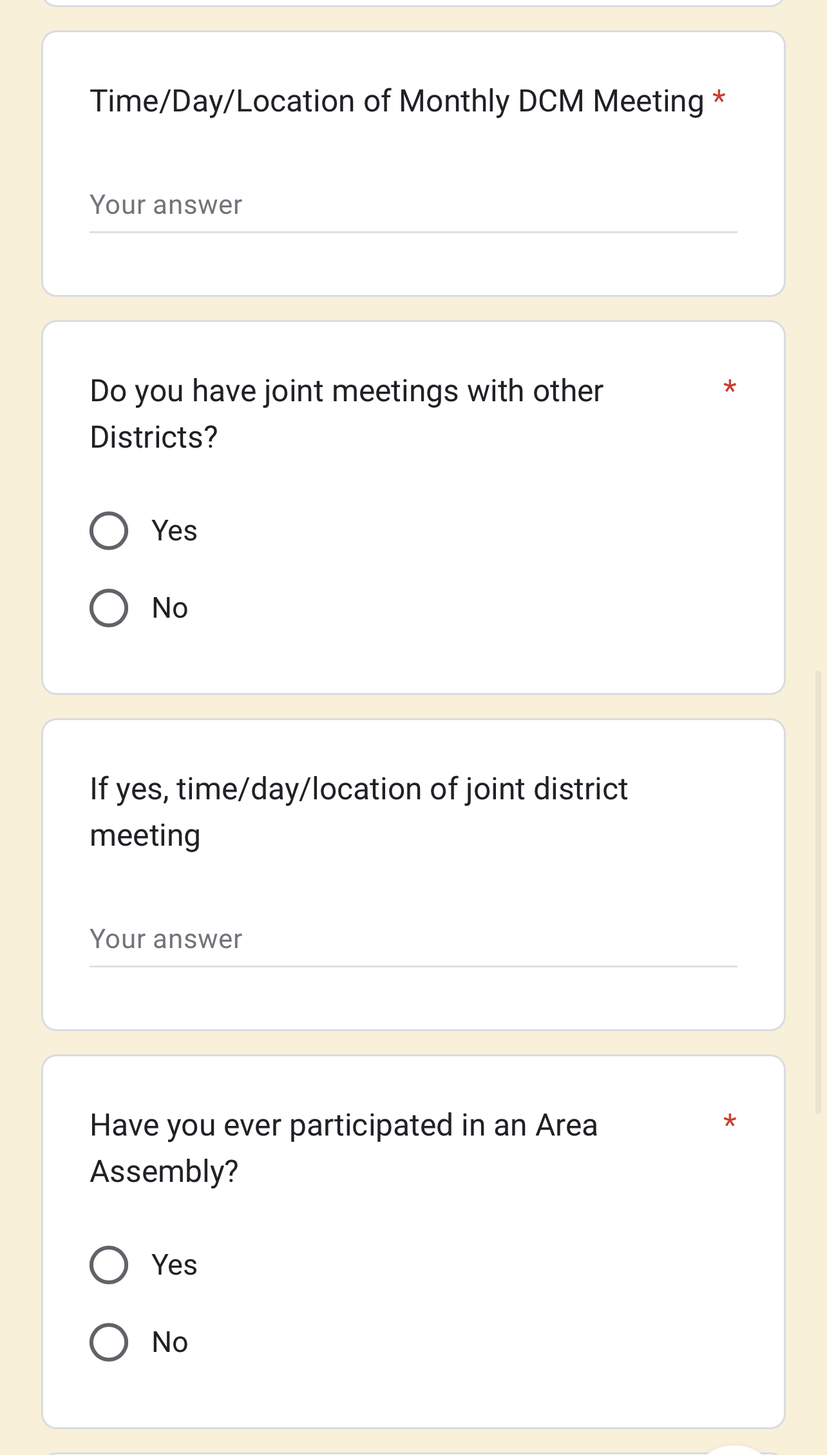
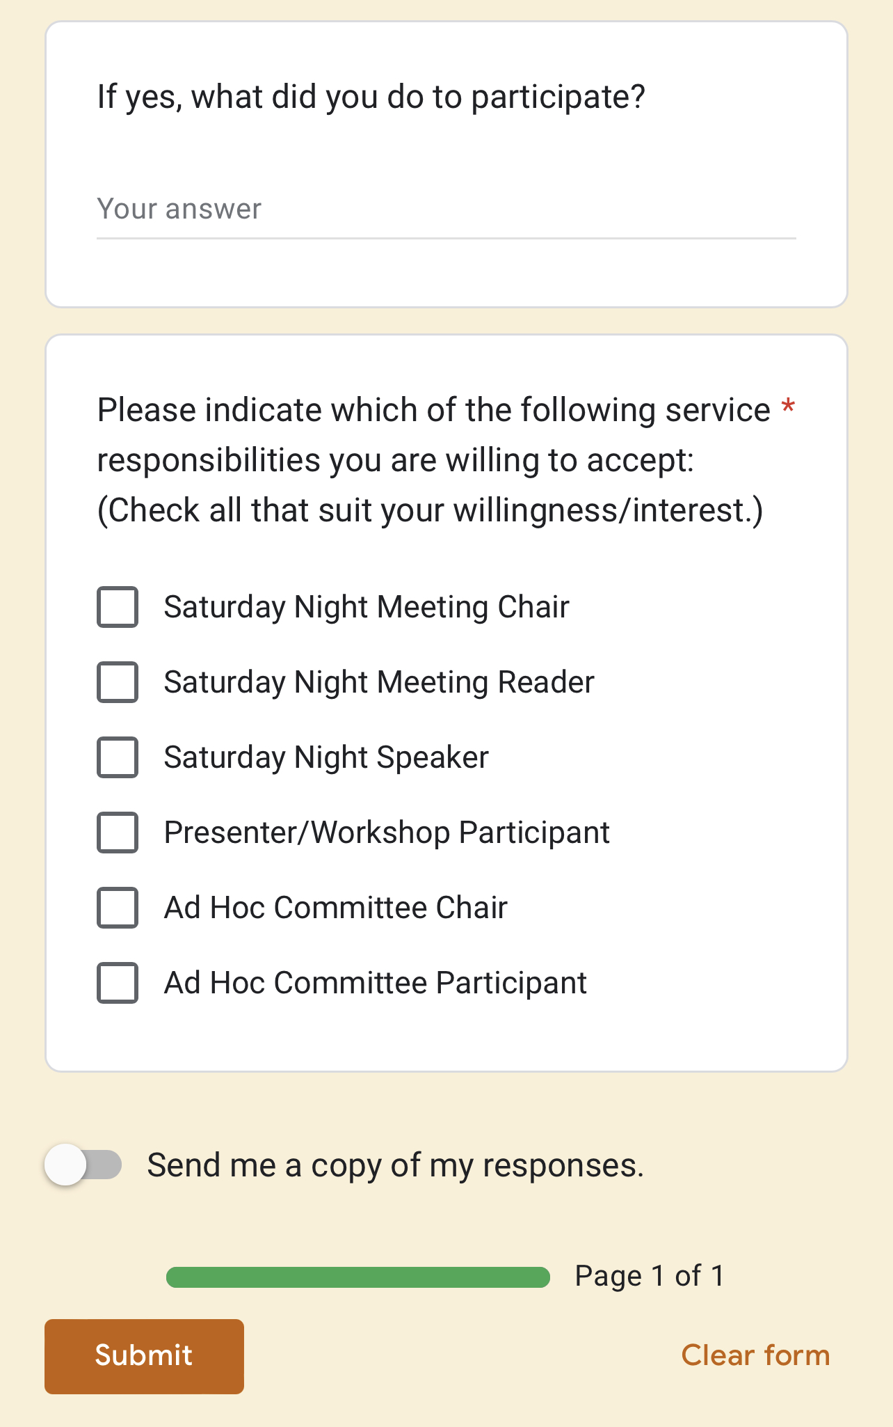
QR code to the home page /click DCM/Alt DCM Questionnaire
aageorgia.org | gssa@aageorgia.org | P.O. Box 7325 Macon, GA 31209 | Phone: 478-745-2588 | Gssa@2006

Slide 9
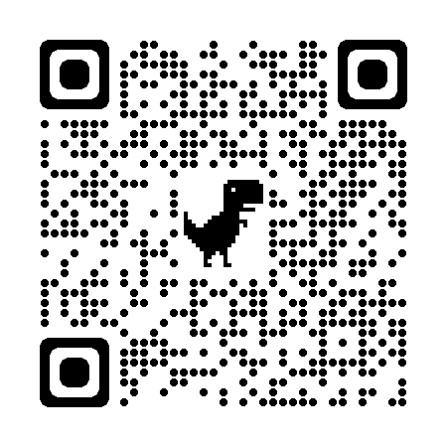
“How to access your DCM email”
QR links to the service & you can view the instructions
From the home page:
Follow the instructions:

Slide 10
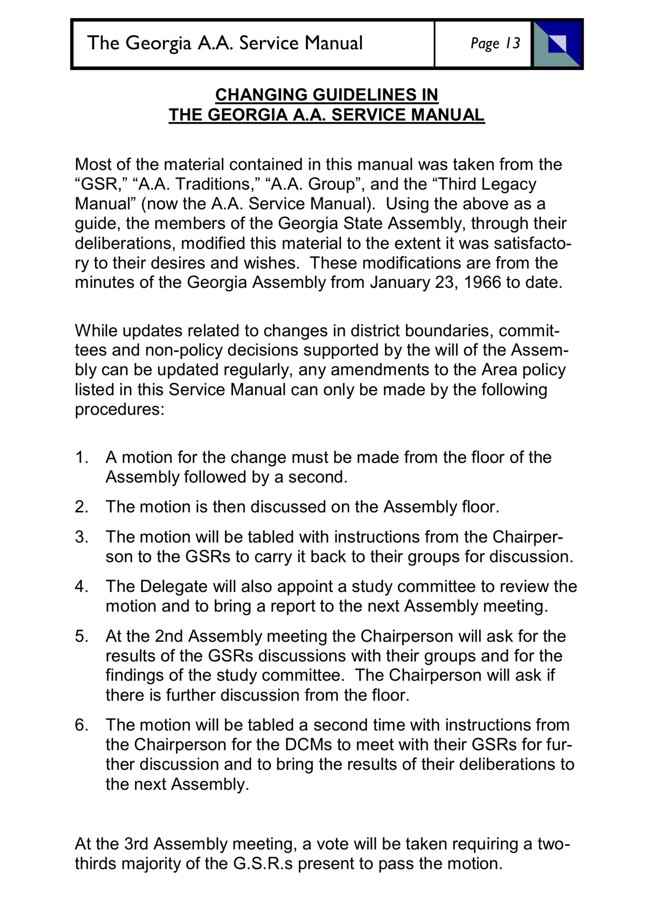
Service Manual changes and Motions
aageorgia.org | gssa@aageorgia.org | P.O. Box 7325 Macon, GA 31209 | Phone: 478-745-2588 | Gssa@2006

Slide 11
Motion Forms
Download the app
aageorgia.org | gssa@aageorgia.org | P.O. Box 7325 Macon, GA 31209 | Phone: 478-745-2588 | Gssa@2006

Slide 12
aageorgia.org | gssa@aageorgia.org | P.O. Box 7325 Macon, GA 31209 | Phone: 478-745-2588 | Gssa@2006

Slide 13
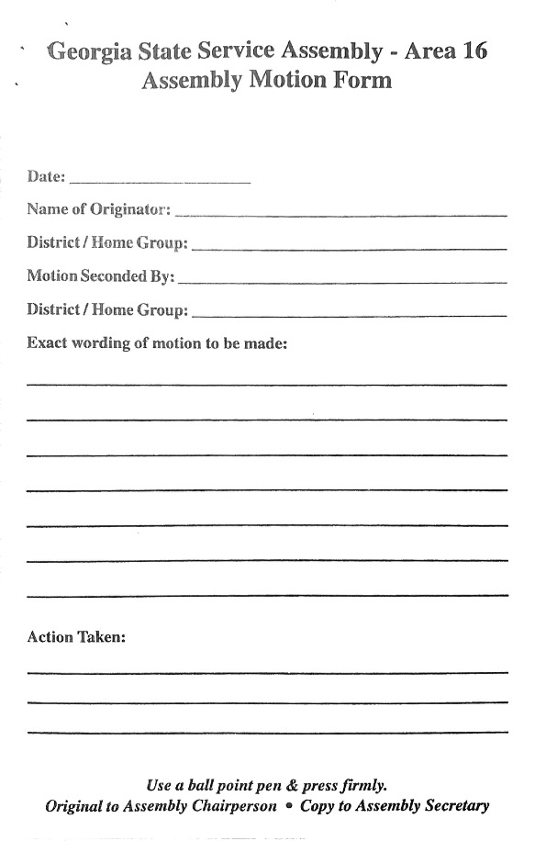
This form is in triplicate:
To the Chairperson
To the Secretary
To the Motion Maker
aageorgia.org | gssa@aageorgia.org | P.O. Box 7325 Macon, GA 31209 | Phone: 478-745-2588 | Gssa@2006

Slide 14
Gssa@2006
aageorgia.org | gssa@aageorgia.org | P.O. Box 7325 Macon, GA 31209 | Phone: 478-745-2588 | Gssa@2006

Slide 15
secretary@aageorgia.org
Bobby O. 706-905-9023
Rule #62…..
aageorgia.org | gssa@aageorgia.org | P.O. Box 7325 Macon, GA 31209 | Phone: 478-745-2588 | Gssa@2006

