Slide 1
Area 16 Alcoholics Anonymous Georgia State Service Assembly January 19, 2020
Delegate’s Sharing
Debi Keane

Slide 2
WELCOME
New GSRs
New DCMs
New Committee Chairs/CoChairs
New Office Committee Member-Alternate Delegate
First time Assembly Attendees
It takes all of us. Thank you for your service!

Slide 3
Alcoholics Anonymous World Services (A.A.W.S.)

Slide 4
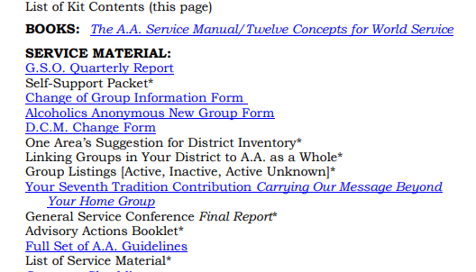
GSR/DCM Kits
GSR/DCM Kits –If you have not received yours, it is available on aa.org
https://www.aa.org/assets/en_US/en_GSR_list.pdf
https://www.aa.org/assets/en_US/f-153_DCM_Kit.pdf
Notes:
GSO is working hard to get these out. Available at aa.org The light blue wording provides a link to the materials

Slide 5
Corrections
The Corrections assignment desk at GSO has received more than 400 letters a month over the last quarter.
GSO is working on generating a data file on all meetings in correctional facilities.
GSO would like input on language alternatives to the terms currently used in corrections literature to refer to INMATES.
A letter to professionals in the parole and probations fields meant to raise awareness on Bridging the Gap will be added to the Corrections Kit.
AAWS Publishing Dept is working with the Grapevine to explore options in contracting with digital implementation of literature into prisons.
Notes:
I will be serving on the Conference Committee for Corrections.

Slide 6
Finance first Nine Months
Literature sales were 1.7% less than budget and 2.7% higher than last year. Gross profit from Literature was $7,292,987
Contributions 4.9% higher than budget $6,197,296
Online contributions accounts for 10.73% of total contributions.
Total revenue- $13,489,284 2.49% greater than budget; 3.76% greater than last year
Expenses- 9.94% greater than last year at 4.53% greater than budget.
Professional fees (contract reviews-ERP contract review was very expensive). AAWS is working on creating a policy for contract reviews and contracted services.
Notes:
Variances are mainly caused by contract reviews being over budget by $119,192 and legal fees $132,915 higher than budget. Contracted services were also over budget mainly due to ERP costs (transition from FNV)

Slide 7
Registration
Notes:
As of Oct 7, 2019, 21,000 people had registered (10,000 in the first 24 hours)
Downtown hotels are filled but many area hotels still have rooms and shuttle buses will be available.
Volunteer sign up will be available in late Feb/early March
This year there will be a General Service Booth along with the usual AAWS and Grapevine booths

Slide 8
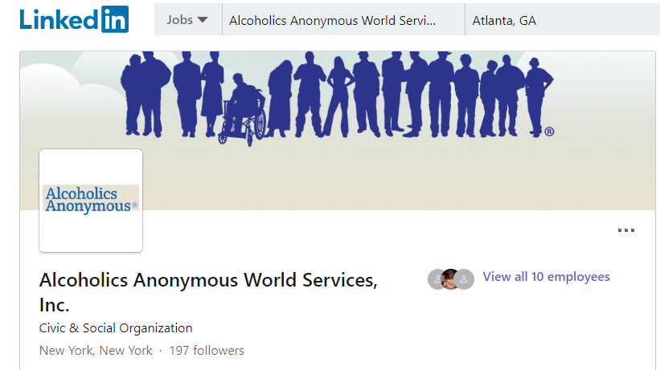
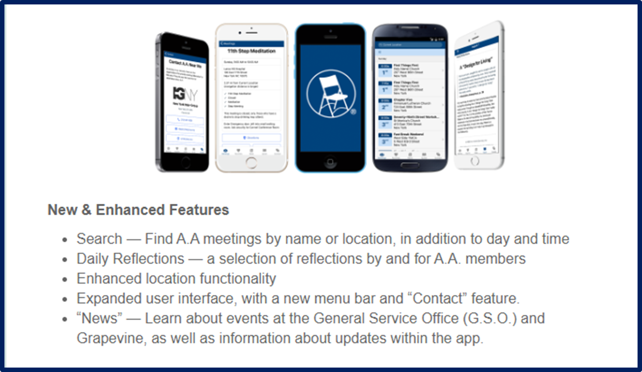
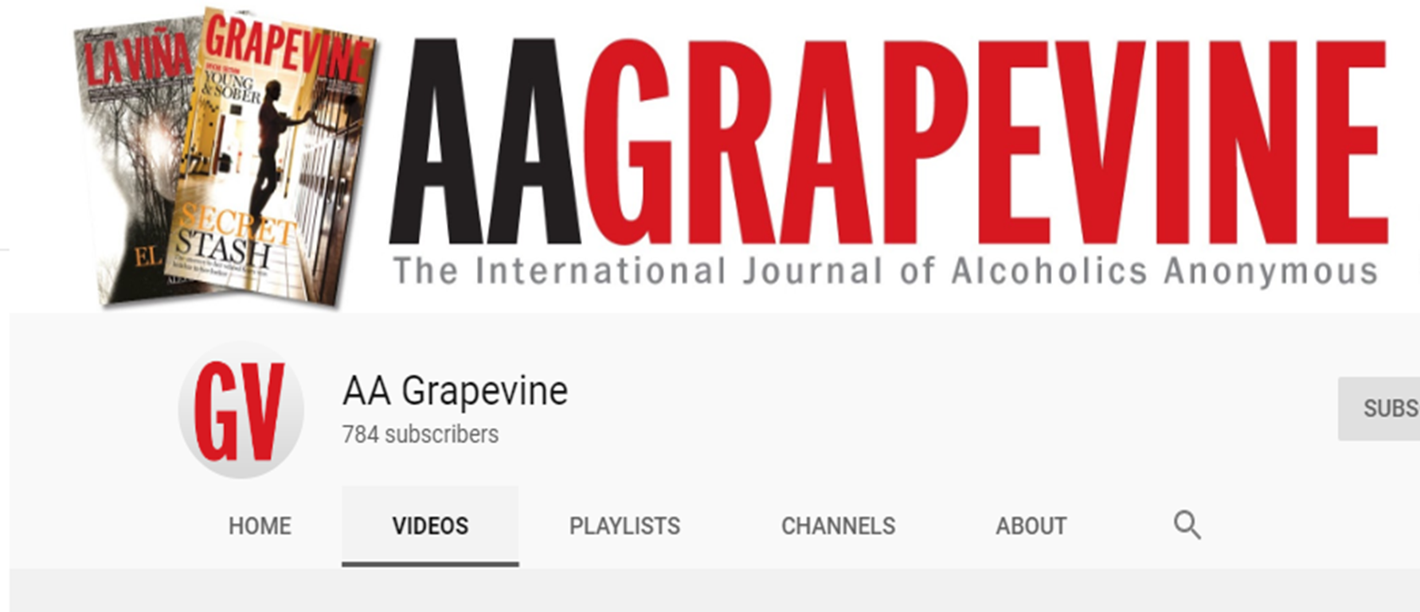
Technology, Communications, and Services
Notes:
The Linkedin page will be under the purview of the CPC desk to update and respond to requests. The implementation plan includes suggestions for the 2019 CPC Conference Committee Considerations and 2018 Advisory Action.
The YouTube Channel is maintained by GSO for the US and Canada and includes the AA Preamble in the description.
There are videos published in English, French, and Spanish that include PSAs and videos for professionals. The YouTube channel name is Alcoholics Anonymous World Services, Inc. They are working on getting all videos published on the A.A. website onto the YouTube Channel.
There are currently 17 videos posted on the AA Grapevine YouTube Channel. These include audios of stories that were printed in the GV and a video from Class A Trustee Nancy McCarthy on using the GV for CPC work.
A recent podcast you may want to check out features a report from George W. an appointed committee member on his efforts to communicate with senior personnel in the military including possible interviews at a US Army Nation ratio station.

Slide 9
Playlists on YouTube
Notes:
There are videos published in English, French, and Spanish that include PSAs and videos for professionals. The YouTube channel name is Alcoholics Anonymous World Services, Inc. They are working on getting all videos published on the A.A. website onto the YouTube Channel. YouTube videos can be close captioned for the hearing impaired.
A recent podcast you may want to check out features a report from George W. an appointed committee member on his efforts to communicate with senior personnel in the military including possible interviews at a US Army Nation ratio station.

Slide 10
Doors PSA

Slide 11
Grassroots Sharing on AA and Technology
Three-part series in Box 4-5-9
Part 1 The Meeting Guide App (Fall 2019)
Part 2 NAATW and TIAA
August 2014 National A.A. Technology Workshop (NAATW)
Technology in A.A. (TIAA) online forum
Technology is changing the way A.A. communicates to suffering alcoholics and interacts with its members
Important to present tech issues from the perspective of A.A. members.
Ongoing forums online for interested members (over 700).
Sign up at tiaa-forum@aa.org

Slide 12
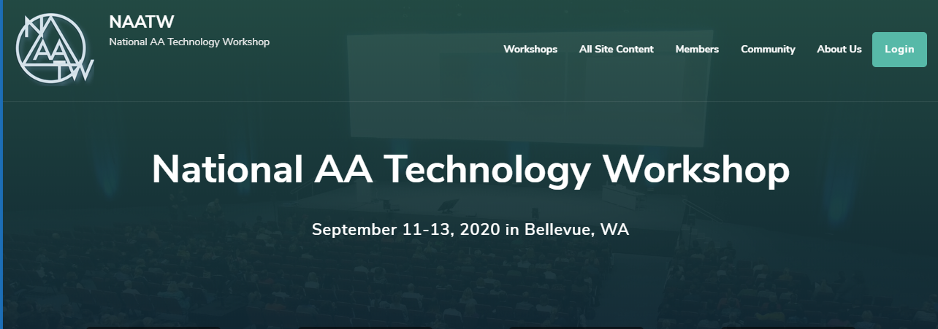
Notes:
NAATW- based on the model of the National AA Archives workshop

Slide 13
Supporting our Primary Purpose
Notes:
NAATW published 12 statements of technology. Begin with implementing technology where it supports our Primary Purpose, making an informed group conscience as part of technology decision-making, and using technology to make information available, not limit it.

Slide 14
What Would Bill Wilson DO?
Notes:
Our communications audit activity, Your Voice Matters indicated clearly that we do not differ on Carrying the Message to the still suffering alcoholic. Keith D. member of NAATW steering committee stated of Bill W, “I’m willing to bet if he were alive today, he’d say “how can we use this to make AA more effective?”

Slide 15
Extending the Hand of A.A.
Alcoholics who are Deaf can access A.A.’s program of recovery in an updated American Sign Language translation of Alcoholics Anonymous.
Notes:
In an effort to make the program of recovery available to all members, AAWS has published an American Sign Language Translation of the Big Book! It is available on DVD for those who need ASL translation.
ASL translation will be available at the 2020 International Convention and videos will be made available for sale post-convention

Slide 16
Literature
Revision of several pamphlets including
A.A.’s 3 Legacies
Twelve Traditions Illustrated
Too Young? Young People in A.A.
A.A for the Black and African American Alcoholic
New Video in the works- GSO, Grapevine, General Service Structure
Revision of the AAWS Policy on the Publication of Literature
Notes:
Third bullet-this was the result of a floor action The AAWS Policy on Publication of Literature: Updating pamphlets and other A.A. material from the 69th GSC to recommit to the Trustee’s literature committee with an updates proposed policy to be brought back to the 70th GSC.

Slide 17
We Need Your Input
Are you familiar with any of the following?
EZ Big Book produced by Hazelden
Manuscripts located online removing language
around the word “God” from the first 164 pages
Manuscripts located online removing
gender language from the first 164 pages
Report to 2020 Conference
Notes:
A subcommittee tasked with the important work of
providing research and background to help facilitate discussion
on some of the agenda items regarding changes and
modifications to the Big Book.
A piece of this research is looking into work created
and produced by members or entities outside of the General Service Office
and not been approved by the General Service Conference. Some of these items include:
so I can contact Katie
I would request any contacts please be sent to me over email at katie.heilmann@yahoo.com
In love and service,
Katie Heilmann
Appointed Committee Member, Trustee’s Literature Committee

Slide 18
Publishing
Translations
Lesotho is in final review stage
Shona translation (Zimbabwe)
Guarani (Paraguay)
Also recent activity for Hungary, Ukraine, India,
and the Czech Republic

Slide 19
From the International Desk
Notes:
The delegate who represented Zimbabwe at the Sub-Sharan zonal meeting in South Africa reported making progress with carrying the message into correctional facilities there. Meetings started in two prisons!! AA Continues to grow around the world!

Slide 20
Grapevine/La Vina
Grapevine –electronic distribution in prisons
Overall circulation is down
LaVina subscriptions increased
Thanks to local committee efforts and events- Chest of Hope

Slide 21
Archives
Shared Experiences
Notes:
The Archives committee is looking for input from local A.A. Archivists in order to update the “Shared Experiences” section of the Archive Workbook. Contact Mike or David, our Archivists, if you have any information you would like considered for inclusion.

Slide 22
Public Information
Notes:
Survey of members in A.A. to provide current trends in AA membership
Due for an update.
At the request of the trustees committee on PI, a survey professional from Duke University as been hired to review the current A.A. Membership survey methodology. Final report will be reviewed by the committee this month.

Slide 23
Treatment/Accessibilities
Notes:
Currently collecting stories to update the pamphlet” AA for the Older Alcoholic. See Richard or Karen if you have a story you would like to submit
A steady flow of calls continues from people who are looking for inpatient treatment resources.

Slide 24
GSO Staff Positions
Updating file of applications from members interested in being considered for possible future openings for G.S.O. Staff member positions.
Minimum 6 years continuous sobriety
Service experience at group, possibly district and area
Business or professional experience
Excellent communication skills
Willingness to locate to NY
Interested? More Information? Write: Staff Coordinator, PO Box 459, Grand Central Station, New York, NY 10163 Email: staffcoord@aa.org

Slide 25
What’s New from GSSA

Slide 26
Communications Audit- Next Steps

Slide 27
Be more effective in attracting and retaining those in need of recovery, the Professional Community, AA Members and improve public perception.
Work with Courts
Website/Communications
Committee

Slide 28
Strengthen and unify our messaging.
Website
GV Stories
Speaker Meetings

Slide 29
Leverage our history to become more impactful communicators.
Archives Workshops
Speaker Meetings
Podcasts

Slide 30
Provide guidance in the use of social media and other interactive tools to more deeply engage the fellowship.
GSO Guidelines
Communications/GV Workshops
Protecting our Anonymity but carrying the message

Slide 31
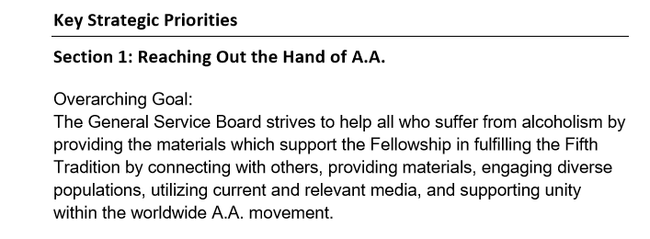
GSB Strategic Plan
Updated Nov. 2019

Slide 32
Area 16 Status Update
Action planning committee working on Action Steps for Georgia to address the suggestions from Your Voice Matters activity

Slide 33
Area Committees
Corrections- collecting data on correctional facilities where we are hosting A.A. meetings. Send info to corrections@aageorgia.org
PI/CPC- continuing to update a data base of all district/group PI/CPC reps. Send info to picpc@aageorgia.org
Treatment/Accessibilities- developing a data base of all district/group treatment reps. Send info to treatment@aageorgia.org
Grapevine- developing a data base of all district/zone/group GV reps grapevine@aageorgia.org.
Notes:
Purpose of the data base is to share information and ideas throughout the year

Slide 34
Vote Today
"GSSA create the position of “Armed Forces and Veterans Chairperson”. The requirements for this position be created similar to the requirements for the other committee chair people found on pages 25-26 of the Georgia State Service Manual."
Please review the AdHoc Committee report from the September Assembly.

Slide 35
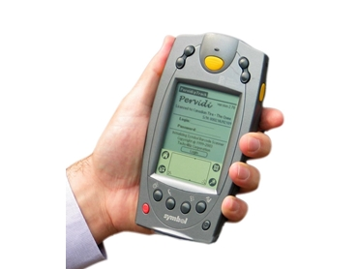
Ad Hoc Committee Reports
Return to eight Cluster Forums beginning in the 2021 calendar year
Move to electronic voting for GSSA elections

Slide 36
Notes:
Our theme this year: A clear vision for you

Slide 37
Debi Keane
delegate@aageorgia.org

